Slide 1
Capstone Project 2: PUBG Final Placement Predictions

Slide 2
Overview:
PUBG is a game where up to 100 players start in match onto an island empty handed and must explore, scavenge and eliminate other players in a free for all until only one player/team is left standing. Kaggle has given us 65,000 games’ worth of anonymized data and we’re asked to predict the final placement in a game given the in-game stats and initial player ratings. Kaggle has asked that we evaluate our model on Mean Absolute Error between the predicted win placement and the observed win placement.

Slide 3
Target Audience:
Within the last 2 years, Battle Royale (BR) styled video games have exploded in popularity, giving us new IPs such as Fortnite and Realm Royale and even affecting long standing franchises like Black Ops. This surge in numbers can arguably be traced back to PUBG, one of the first BR games to receive a substantial amount of development and sustain a large, consistent player pool. The premise of the game is simple: You and up to total of 100 players are dropped onto a large island empty handed and you must explore, scavenge and eliminate other players in a free-for-all/team vs team first person shooter styled battle until only one player or team is left standing. This project aims to use 65,000 games’ worth of anonymized data to predict final placements in a game using over 20 different in-game stats. There are a couple groups of people that would be interested in the results:
The game’s developers: The data analyzed could be used to help conduct balance changes based off of impact of each feature.
The players: The data analyzed could be used to help pinpoint weaknesses in a player’s performance, giving them an objective avenue of improvement to go through.
Tournament organizers: High impact features could be used when casting tournament games, being able to select the top 5 or 10 most impactful stats that players should keep an eye on.

Slide 4
Methodology:
STEP 1
STEP 2
STEP 3
STEP 4
STEP 5
Data Acquisition:
Collect and import the necessary data for analysis
Initial Data Inspection:
Broadly inspect and if necessary clean up the initally imported data
Exploratory Data Analysis:
Summarize main characteristics of the data via visual aids
Inferential Statistics:
Apply statistical tests to determine significant relationships between the features
Machine Learning:
Apply ML algorithms to build predictive models that can give an accurate win place percentage based off the pertinent set of features

Slide 5
Step 1: Data Acquisition
1

Slide 6
Data Acquisition:
The data I will be using can be found on Kaggle (here). The file list includes:
A sample submission file in the correct format
A training dataset (4.45m rows)
A test dataset (1.93m rows)

Slide 7
Data Acquisition:
The columns found in our data are as follows:
DBNOs
Assists
Boosts
damageDealt
headshotKills
Heals
Id
killPlace
killPoints
killStreaks
Kills
longestKill
matchDuration
matchId
matchType
rankPoints
Revives
rideDistance
roadKills
swimDistance
teamKills
vehicleDestroys
walkDistance
weaponsAcquired
winPoints
groupId
numGroups
maxPlace
winPlacePerc - This is our prediction target

Slide 8
Step 2: Initial Data Inspection
2

Slide 9
Initial Data Inspection:
After the initial importing of our training and test files into dataframes, the first step I took was to inspect the different game modes available in our data set. Looking at the list, I’ve split these game modes up as follows:
Standard Game Modes:
Solo Game Modes:
solo
solo-fpp
Multiplayer Game Modes:
squad
duo
squad-fpp
duo-fpp
Non-Standard Game Modes:
normal-squad-fpp
crashfpp
flaretpp
normal-solo-fpp
flarefpp
normal-duo-fpp
normal-duo
normal-squad
crashtpp
normal-solo

Slide 10
Initial Data Inspection:
For reference, Solo games are games where the player is matched solo against up to 100 other solo players. Duo game modes are games where the player and a friend is matched with other partnered teams with a max player count of up to 100 players per game. Squad game modes are games where the player and up to 3 teammates are matched with other similar groups with a max player count of up to 100 players per game. As for FPP vs Non-FPP game types, FPP modes are modes where the players are forced into a first person shooter perspective. However, the remaining mechanics are exactly the same.

Slide 11
Initial Data Inspection:
With these categories in place, the statistics of the number of observations/games for each of the game modes are as follows:
Game Mode | # of Observations | # of Games | Game Mode | # of Observations | # of Games | Game Mode | # of Observations | # of Games
Solo | 181943 | 2297 | Normal Squad FPP | 17174 | 358 | Normal Duo | 199 | 12
Solo-FPP | 536762 | 5679 | Crash FPP | 6287 | 73 | Normal Squad | 516 | 16
Duo | 313591 | 3356 | Flare TPP | 2505 | 29 | Crash TPP | 371 | 5
Duo-FPP | 996691 | 10620 | Normal Solo FPP | 1682 | 96 | Normal Solo | 326 | 23
Squad | 626526 | 6658 | Flare FPP | 718 | 9
Squad-FPP | 1756186 | 18576 | Normal Duo FPP | 5489 | 158

Slide 12
Step 3: Exploratory Data Analysis
3

Slide 13
Data Visualization (EDA):
From here, I choose to focus on the standard game modes as the nonstandard game modes comprising of less than 1% of our data). I split up the training data into the different dataframes that correspond to the game type, I used the .describe method to look at the general statistics of each dataframe, used the .info method to ensure that there are no null values, dropped any unnecessary columns and then used the remaining columns as my feature list. For each feature, a distribution plot was created. In the next set of slides, I will be showing a couple examples of each from each game type. The remaining distribution plots can be found in my source code.

Slide 14
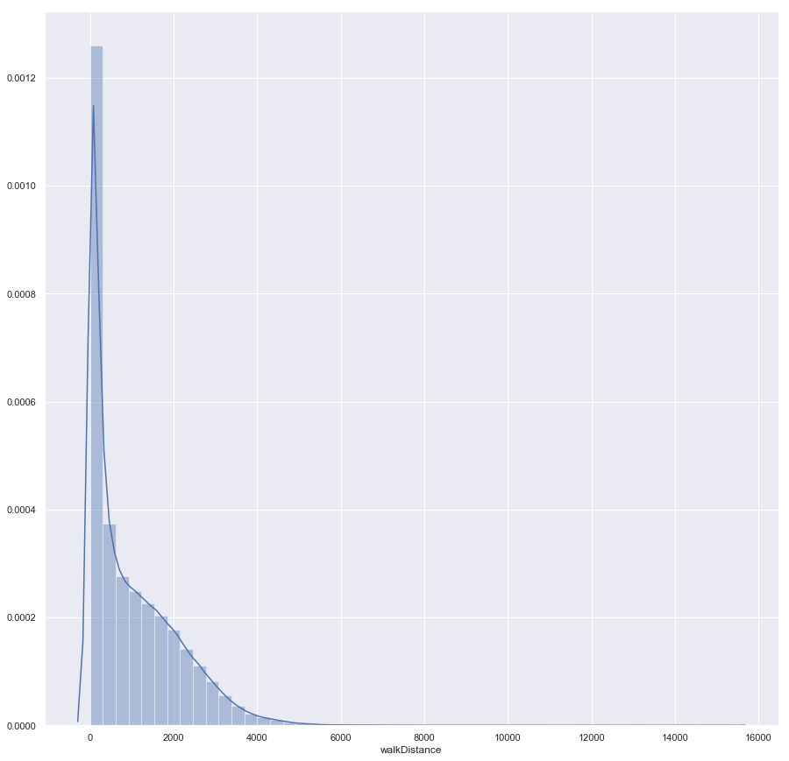
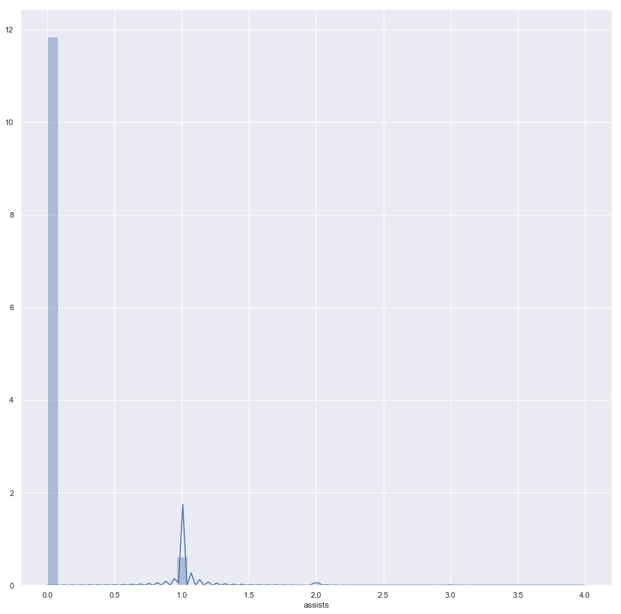
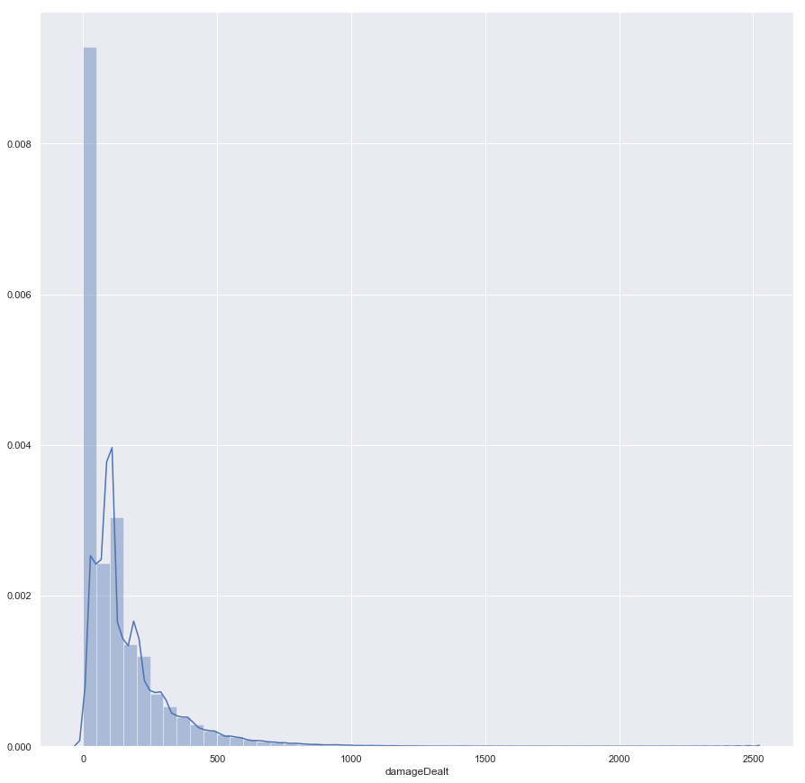
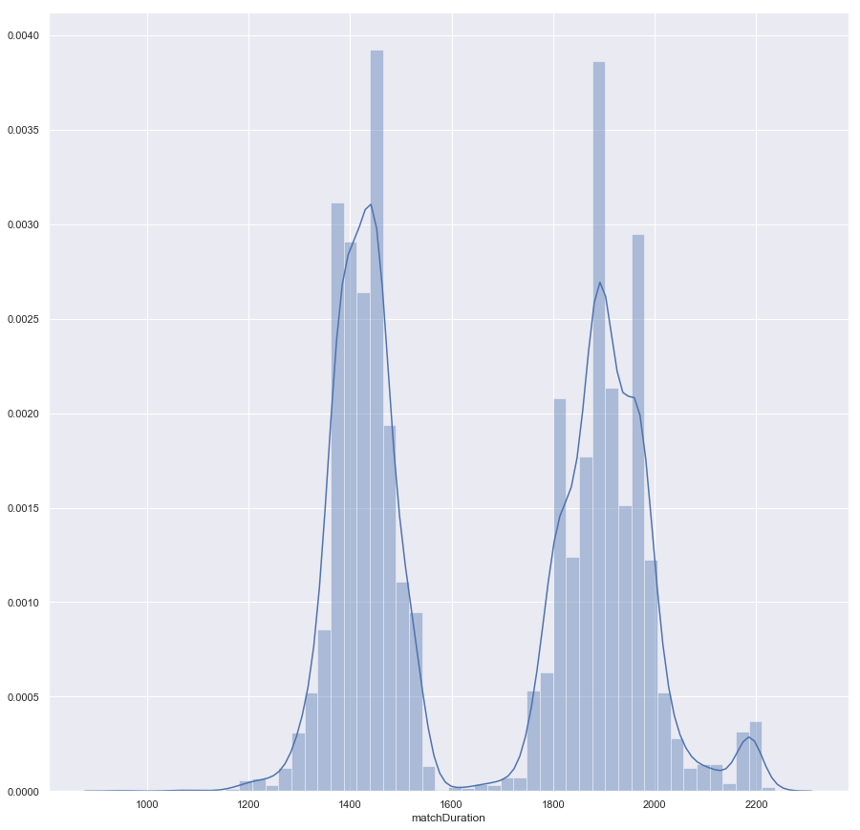
Data Visualization (EDA) – Solo:

Slide 15
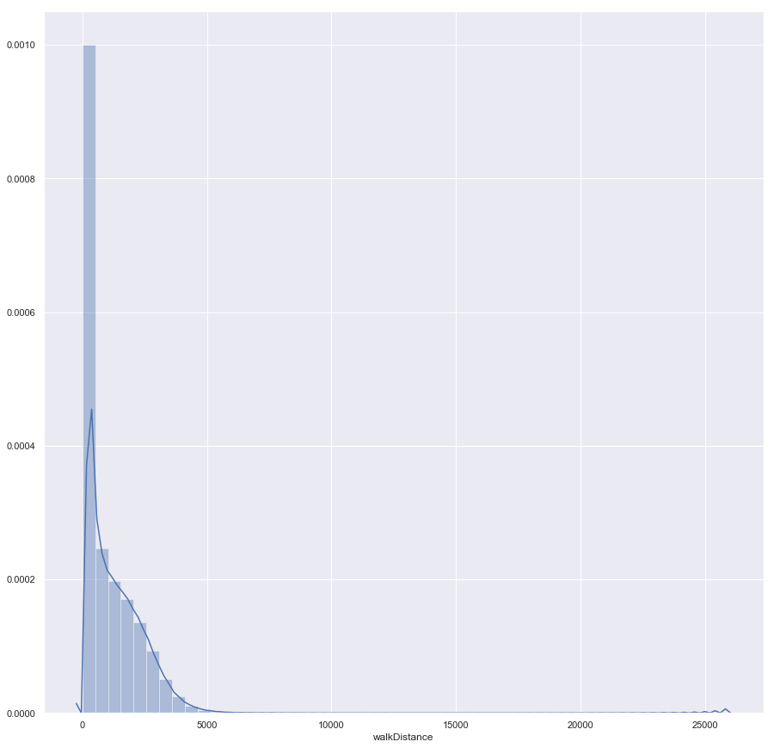
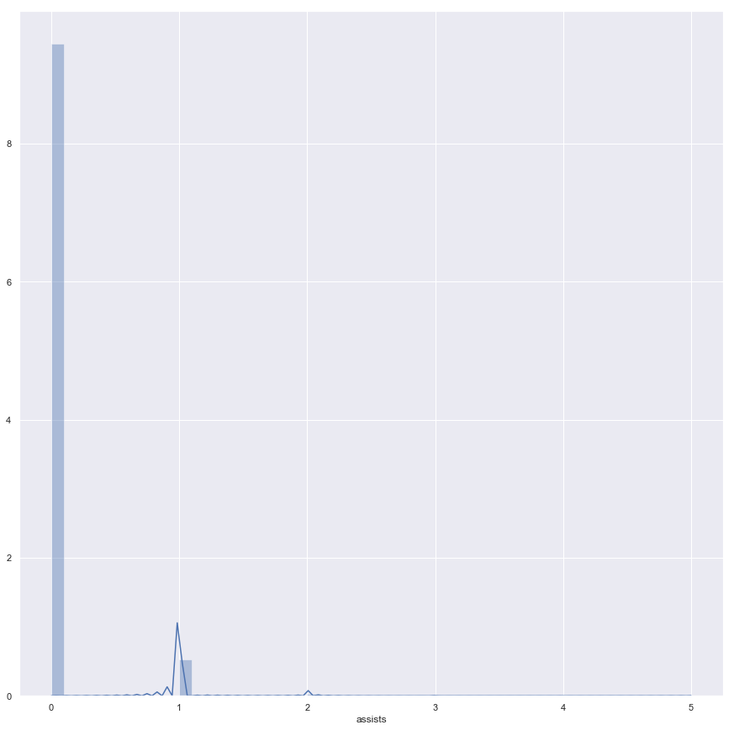
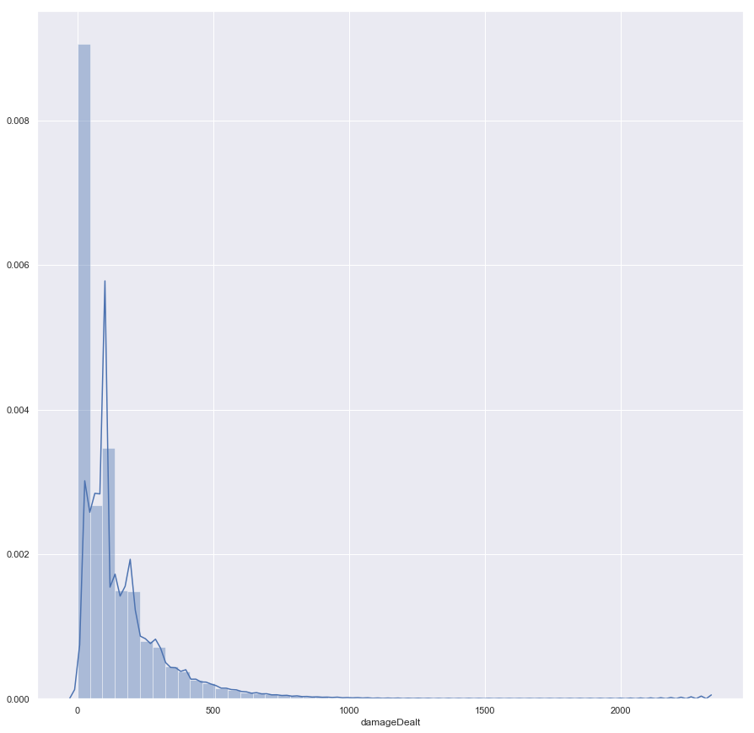
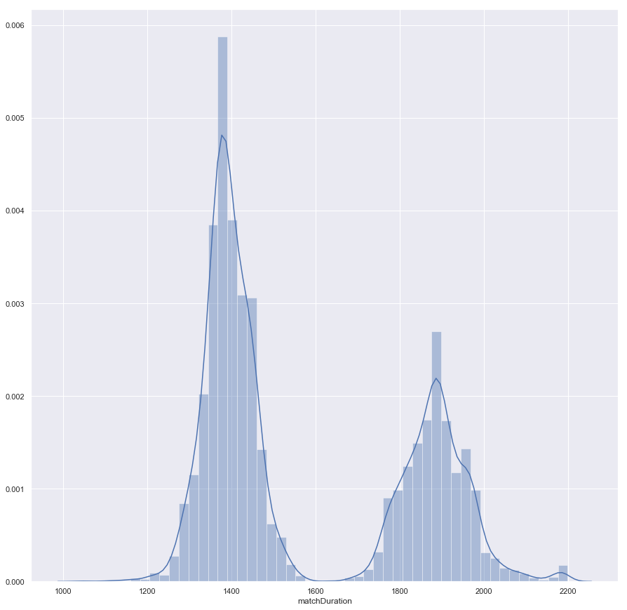
Data Visualization (EDA) – Solo FPP:

Slide 16
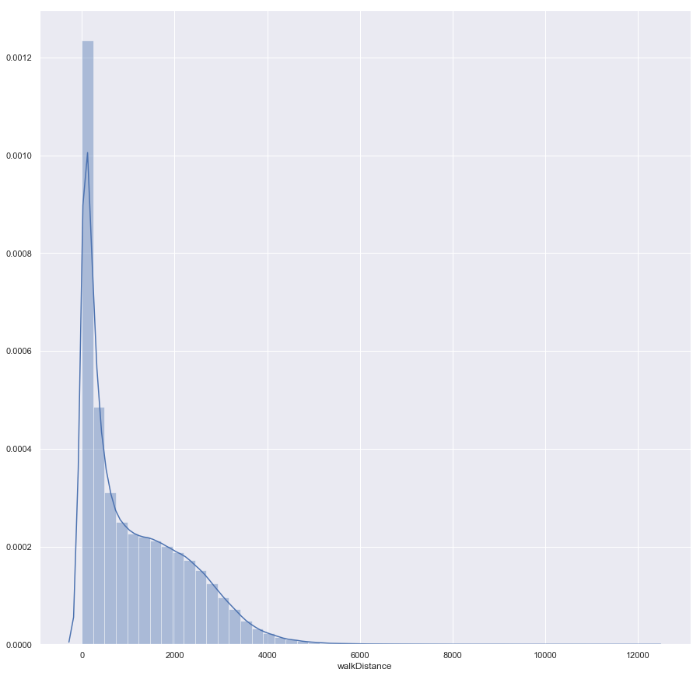
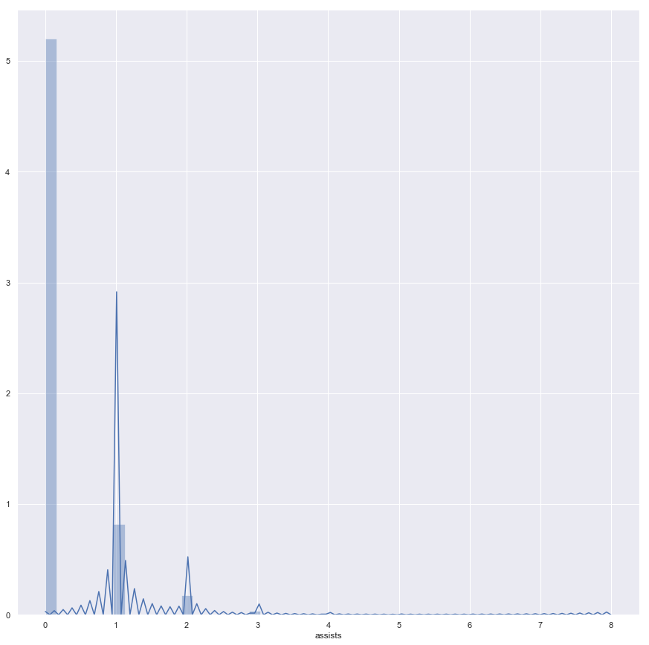
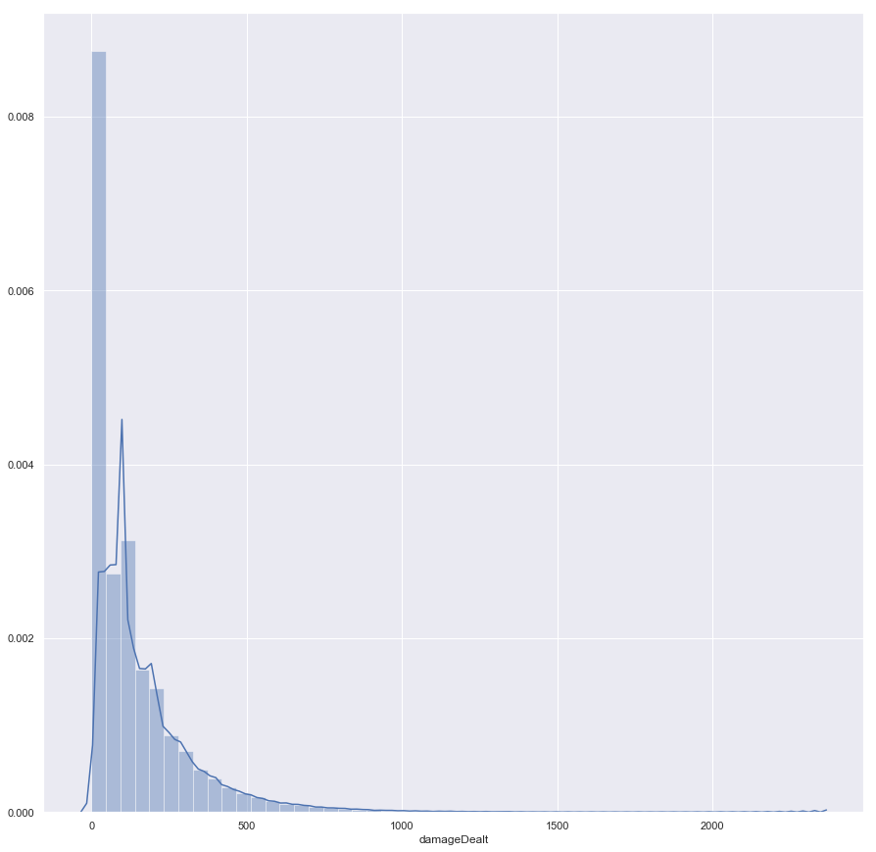
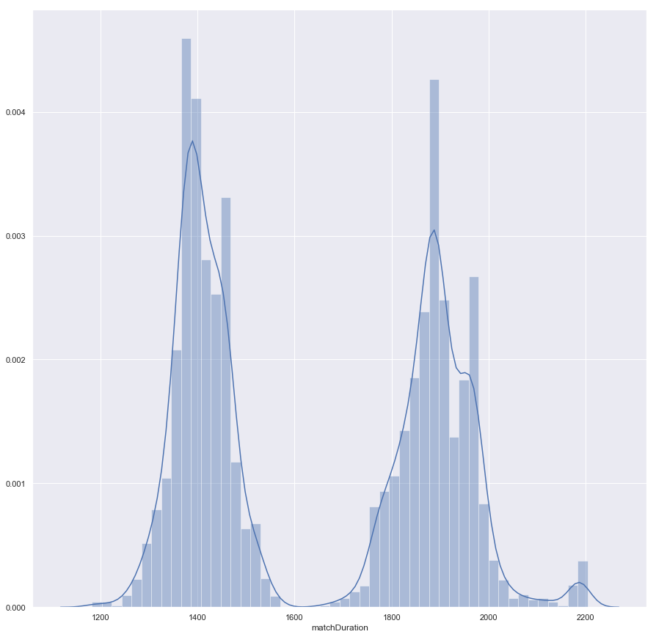
Data Visualization (EDA) – Duo:

Slide 17
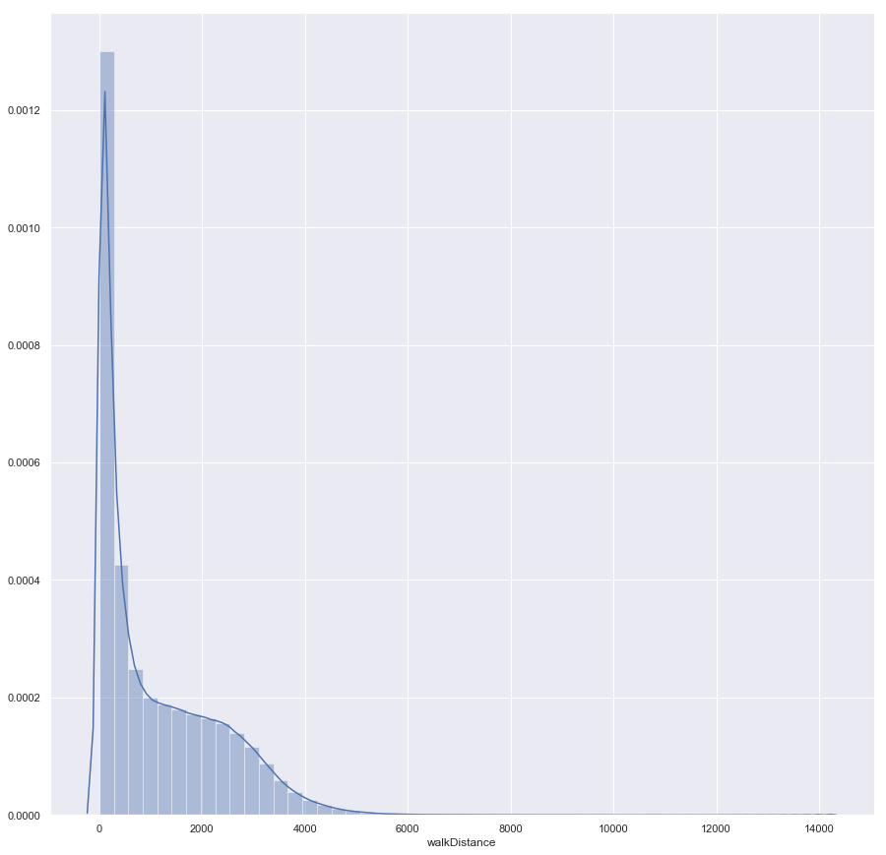
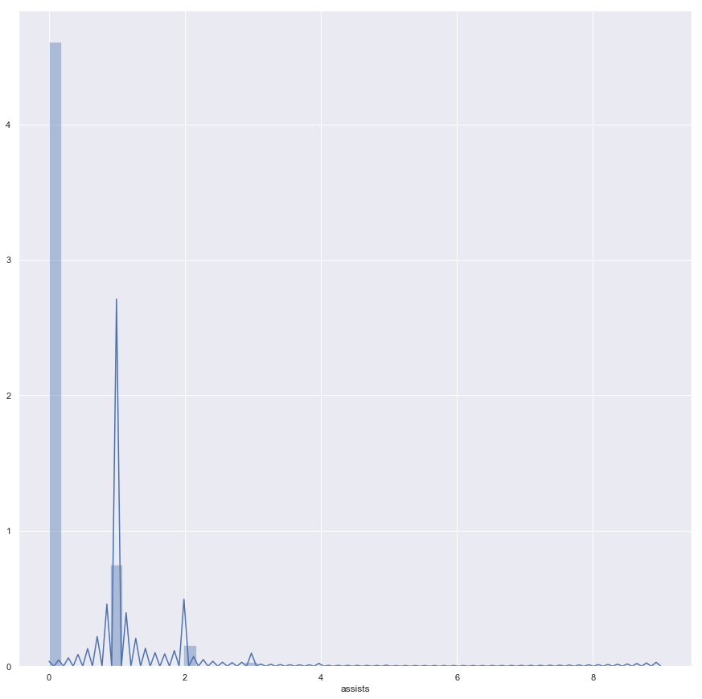
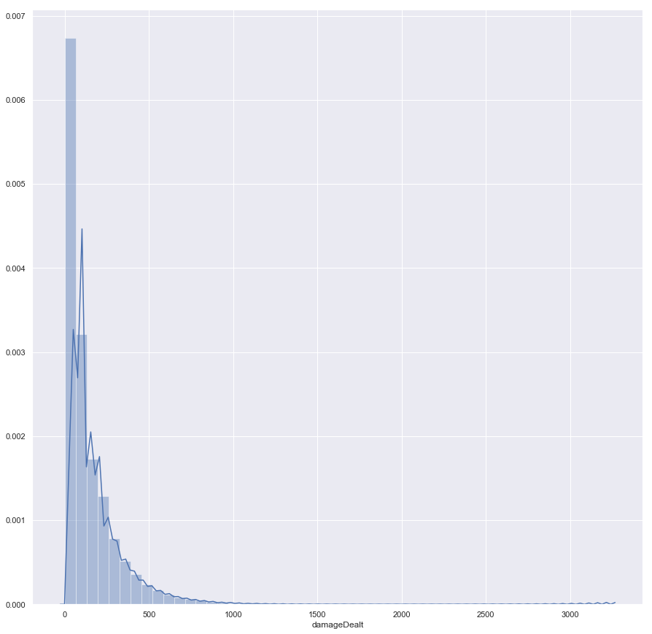
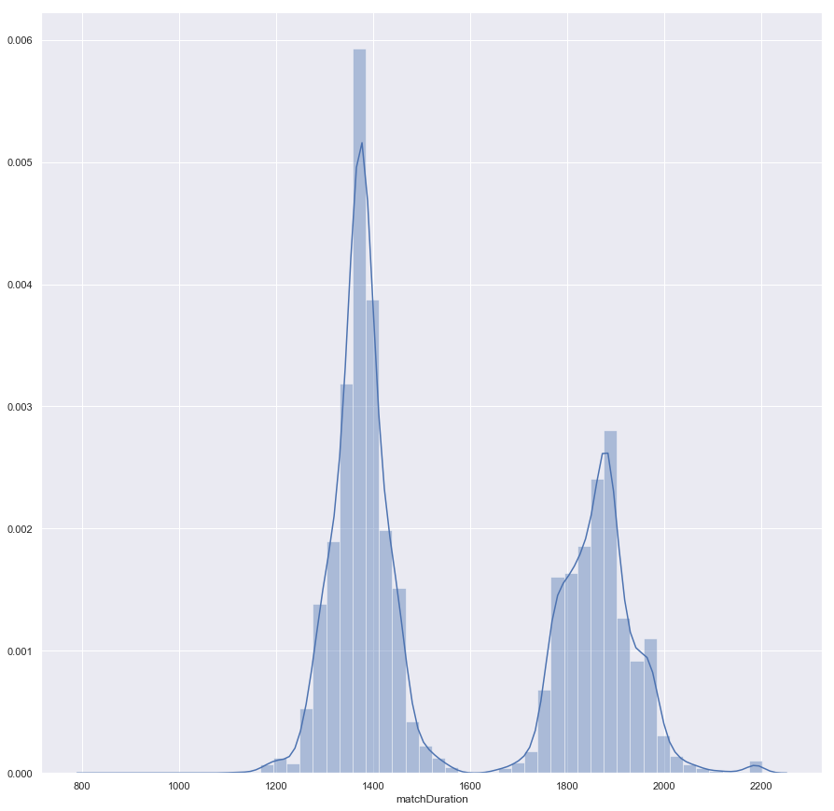
Data Visualization (EDA) – Duo FPP:

Slide 18
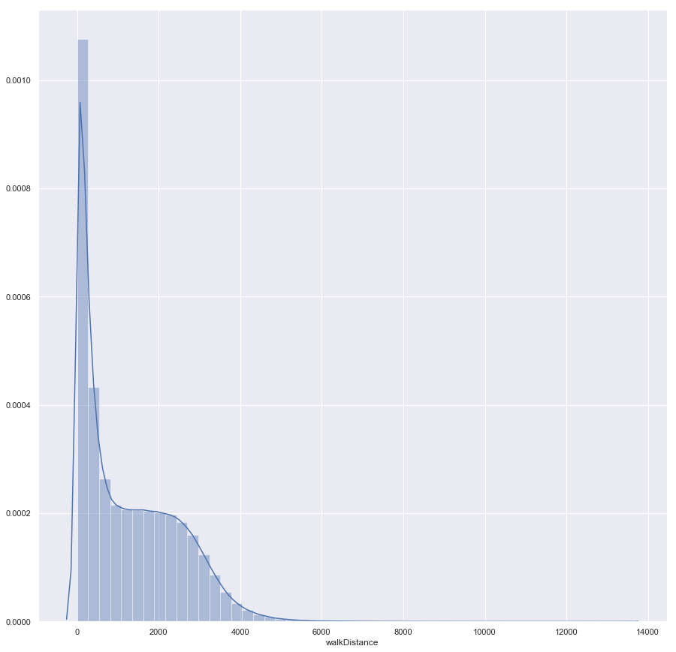
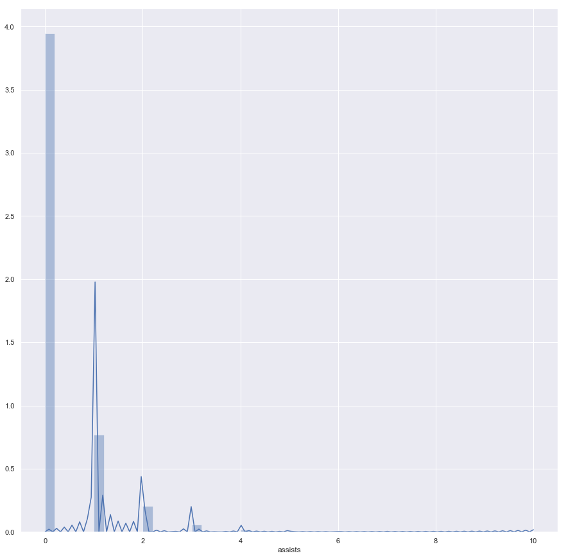
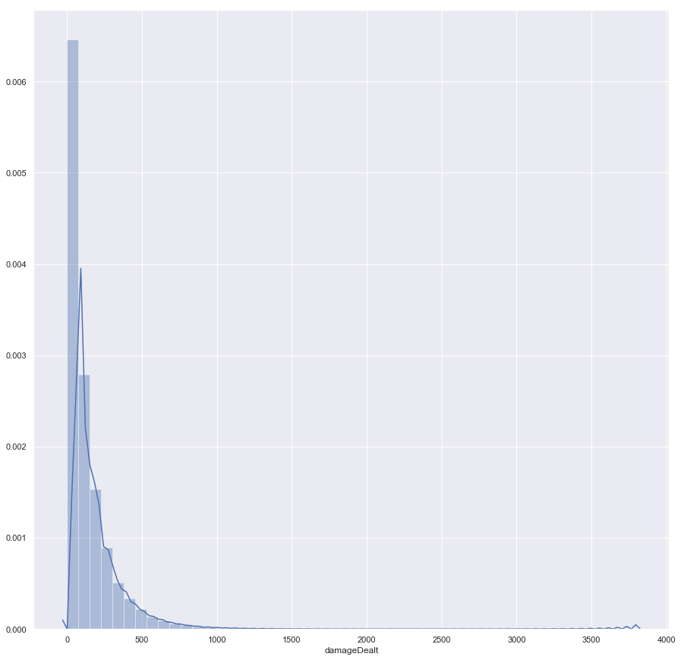
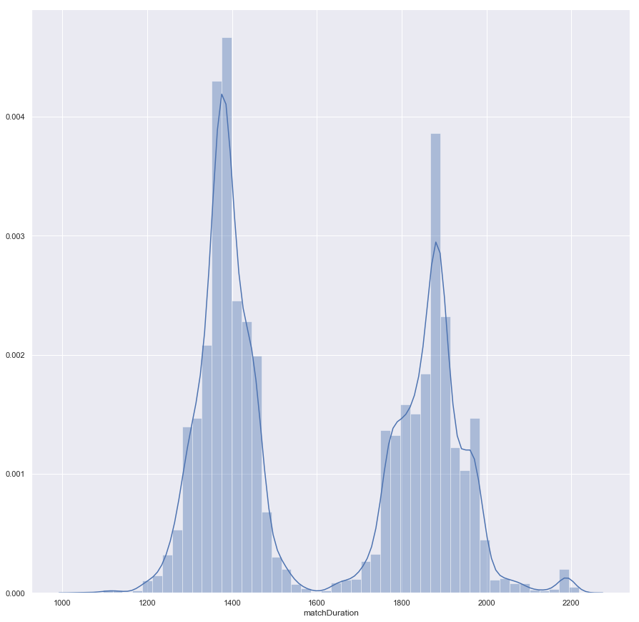
Data Visualization (EDA) – Squad:

Slide 19
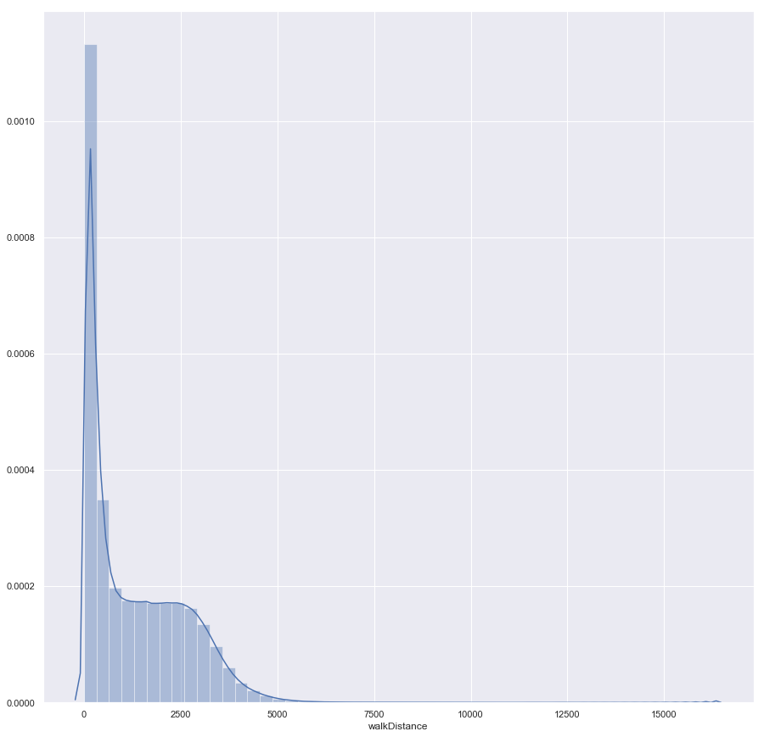
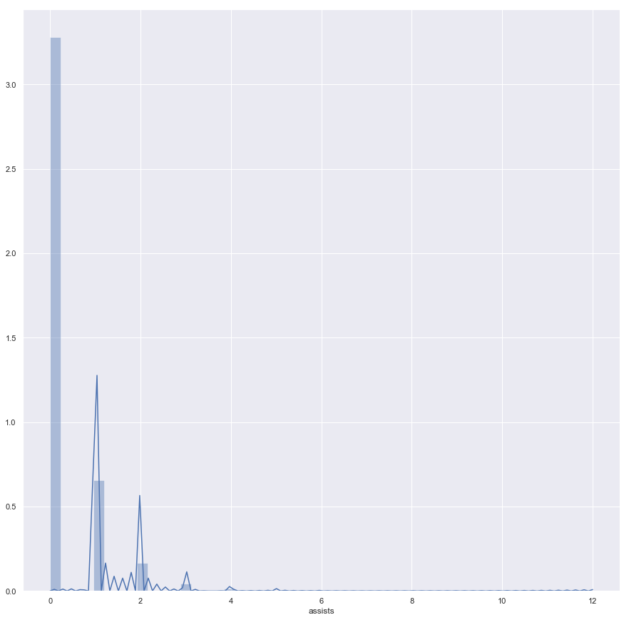
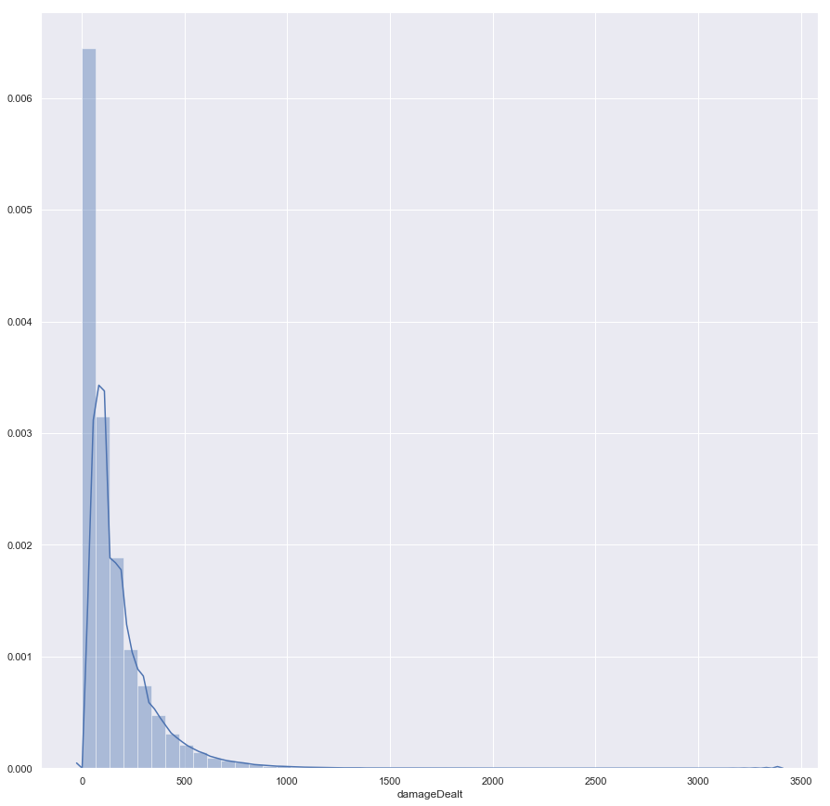
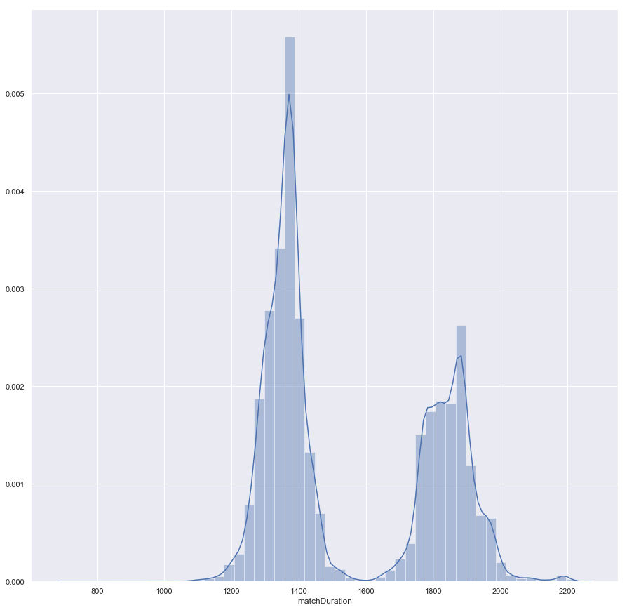
Data Visualization (EDA) – Squad FPP:

Slide 20
Data Visualization (EDA) - Comparisons:
Apart from doing single distribution plots of each dataframe, I also overlaid the FPP and non FPP game mode distributions to give a quick visual aid for comparison purposes. In addition, I did a comparison of the distributions compared across all standard non FPP modes (Solo, Duo and Squad)

Slide 21
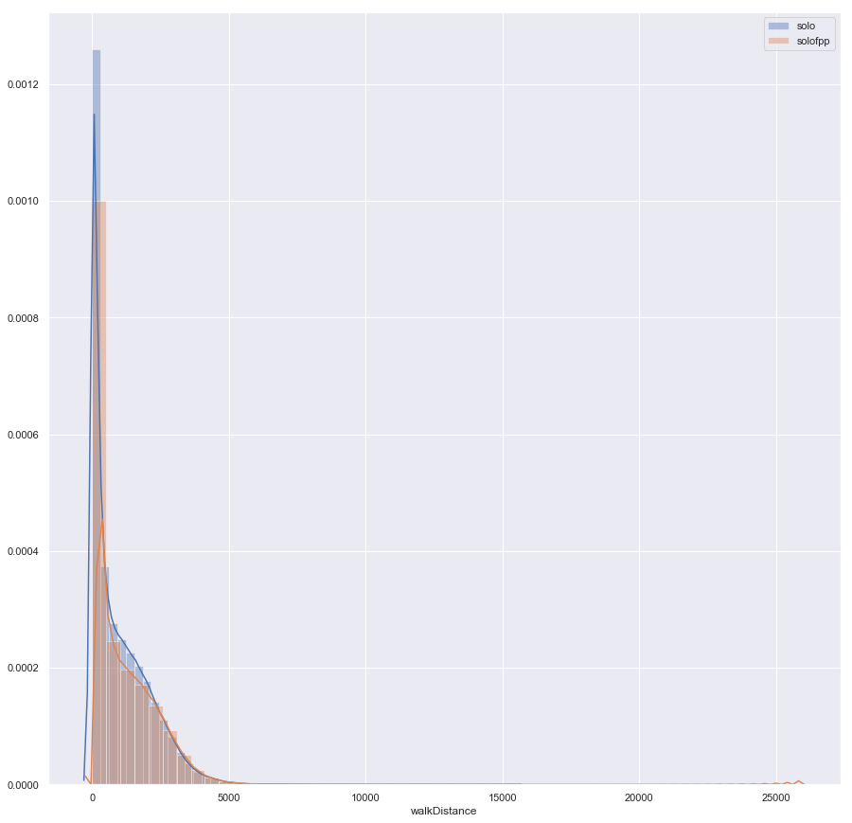
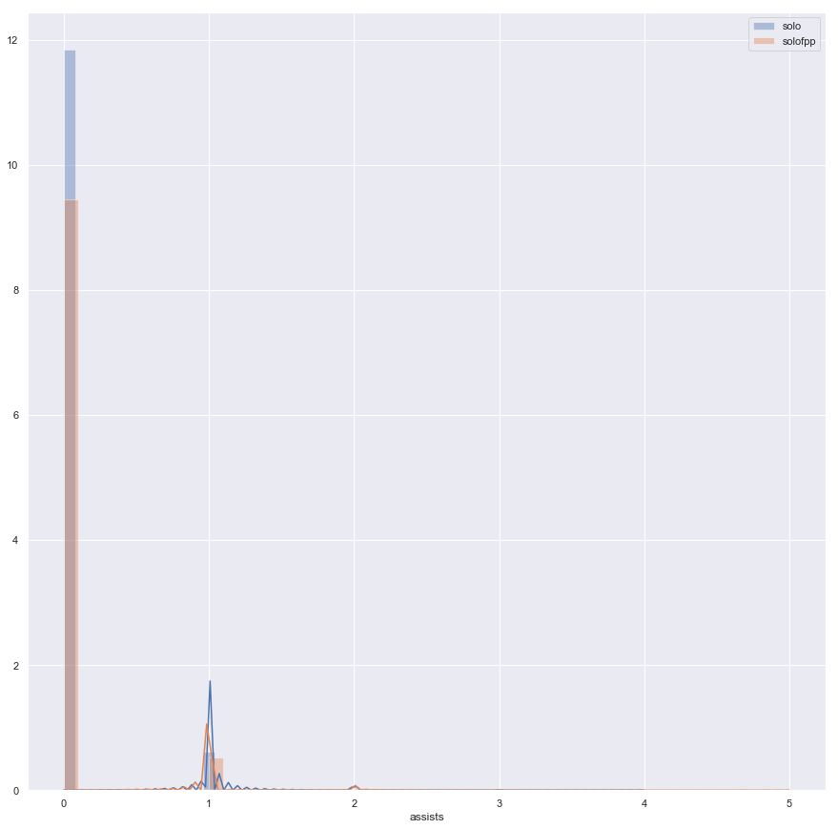
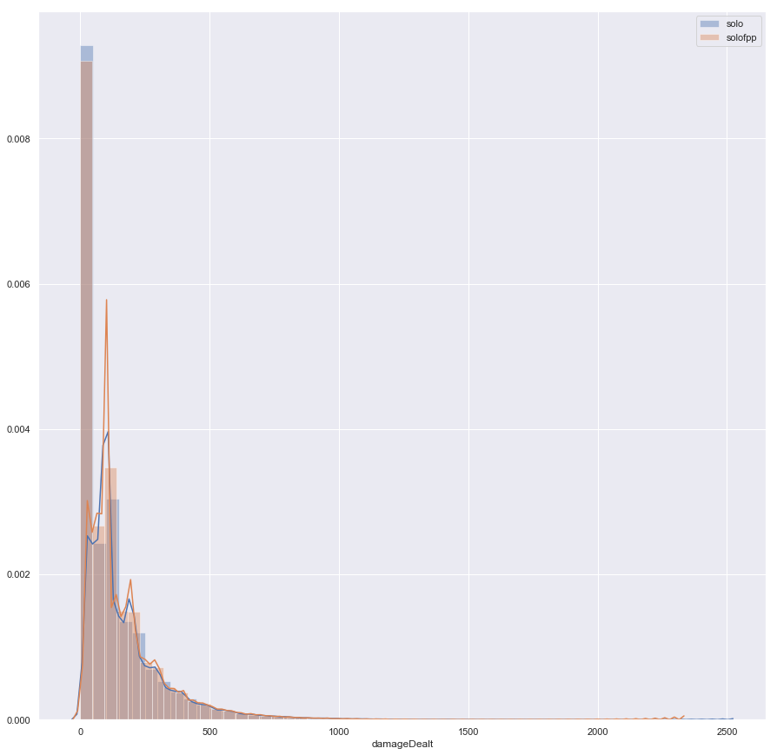
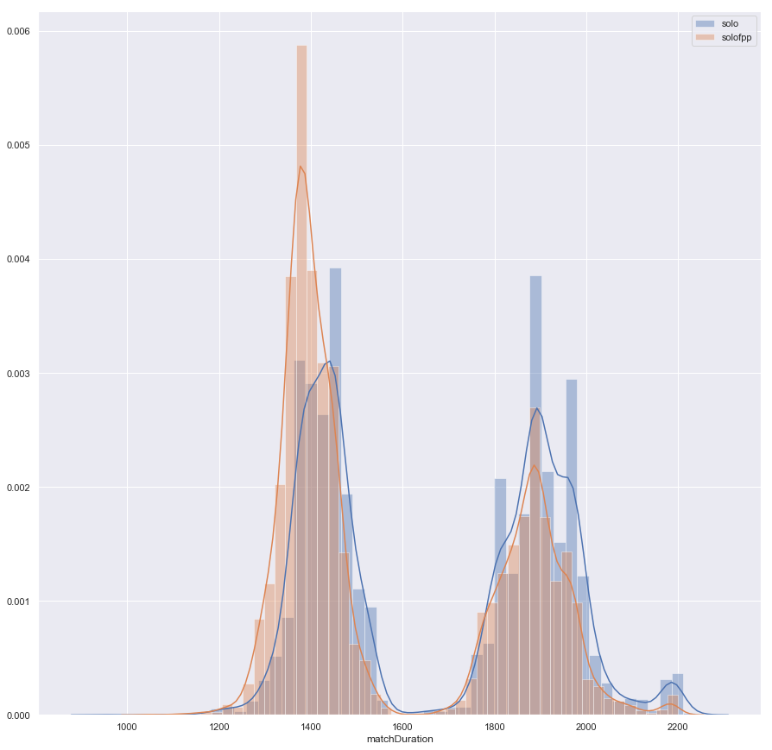
Data Visualization (EDA) – Solo/Solo FPP:

Slide 22
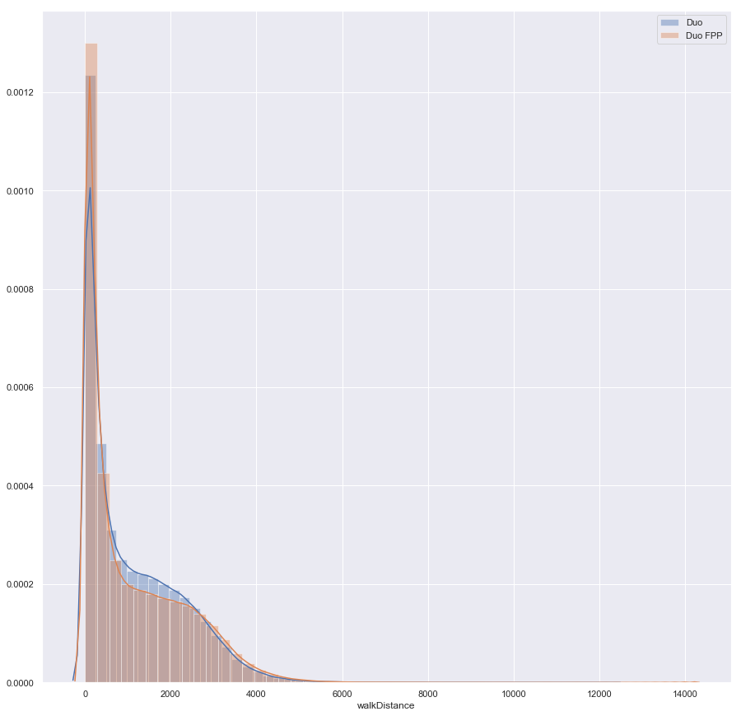
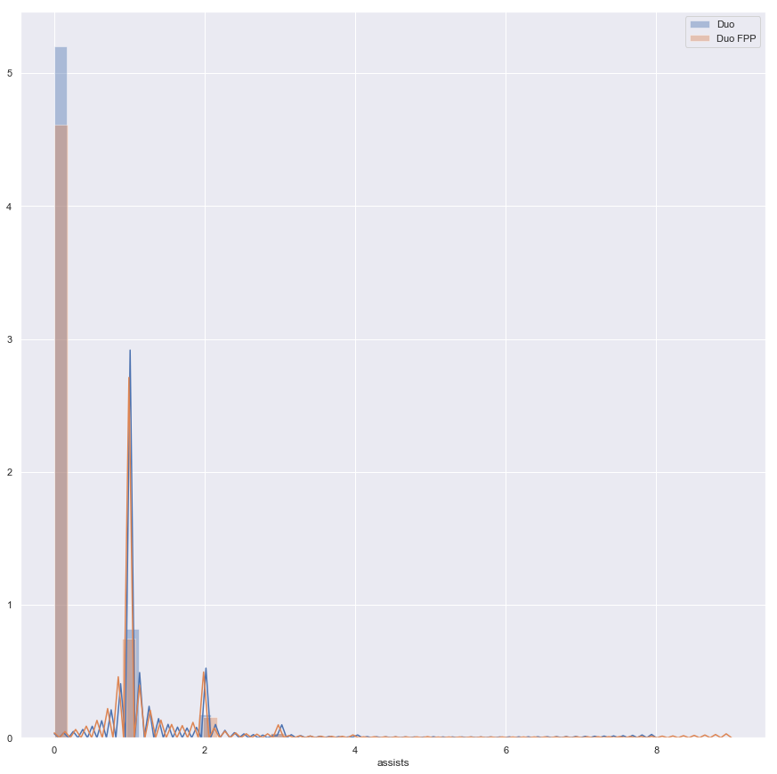
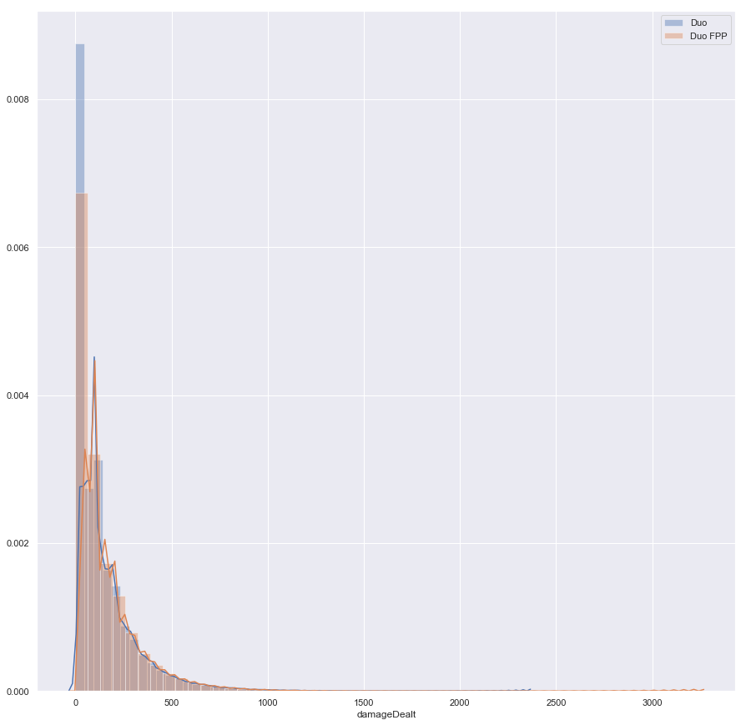
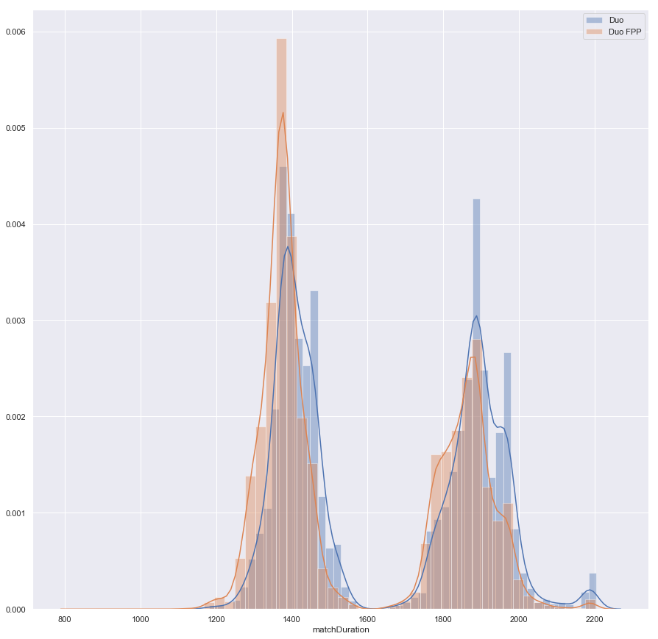
Data Visualization (EDA) – Duo/Duo FPP:

Slide 23
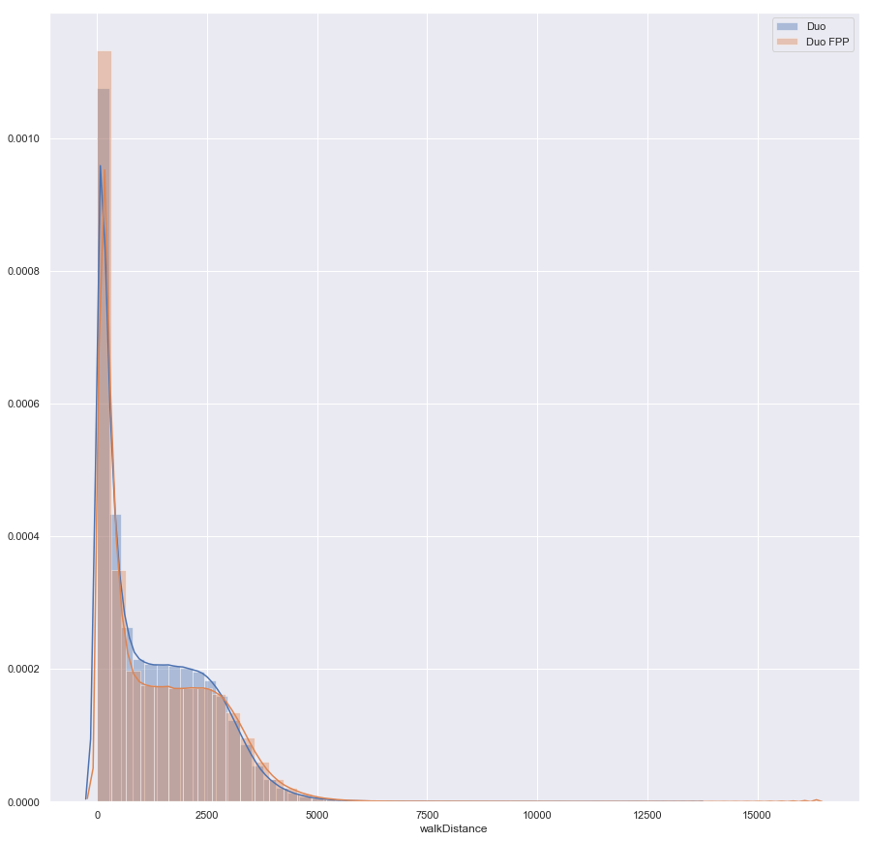
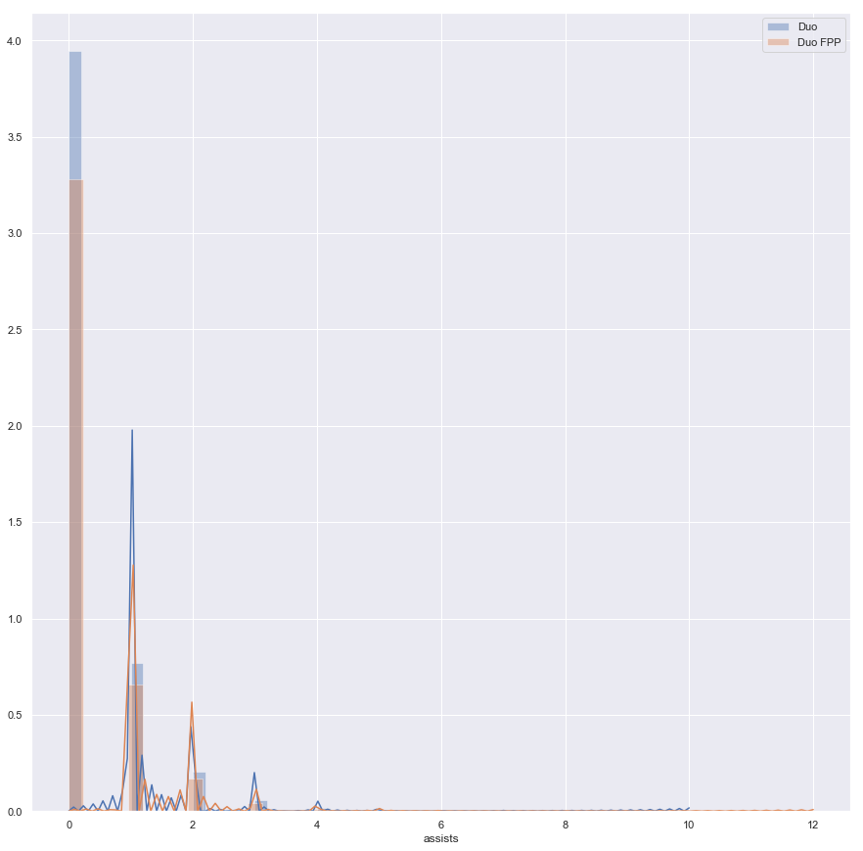
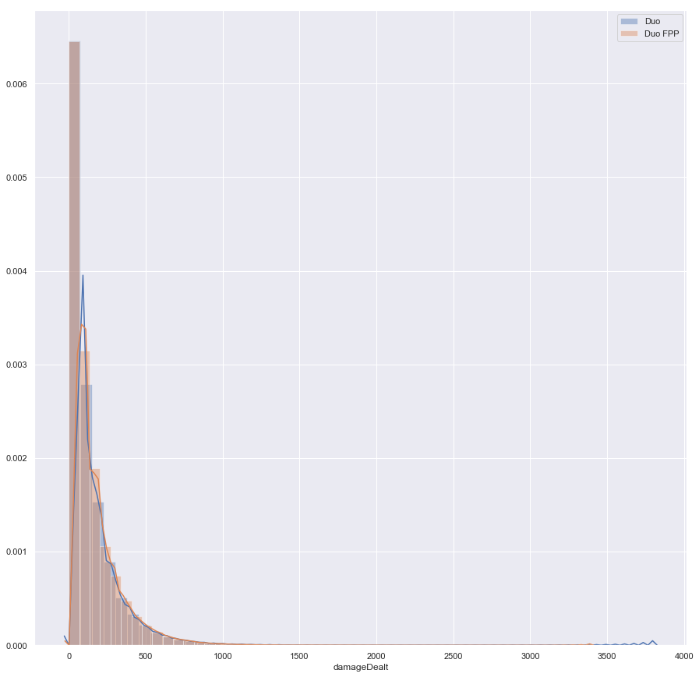
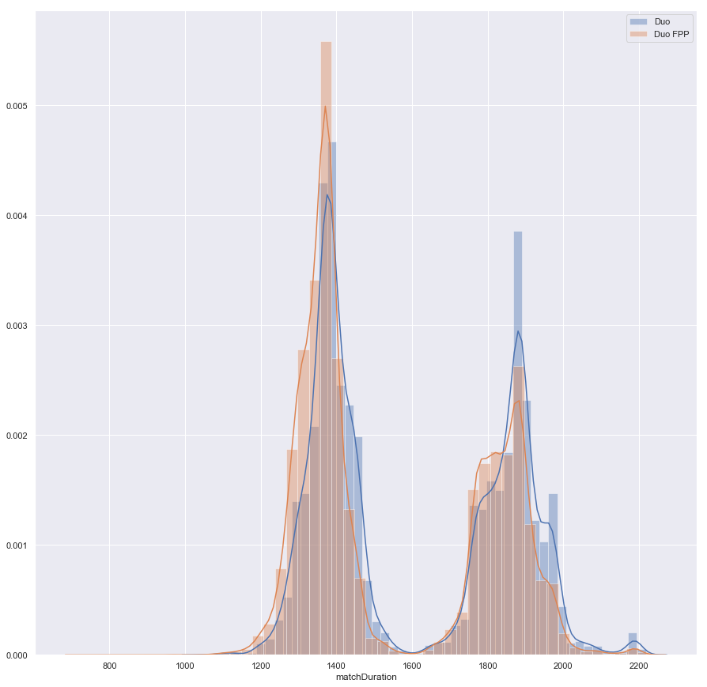
Data Visualization (EDA) – Squad/Squad FPP:

Slide 24
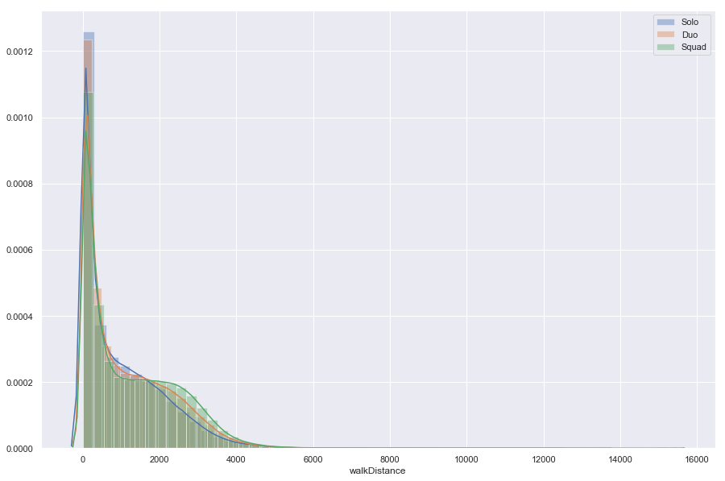
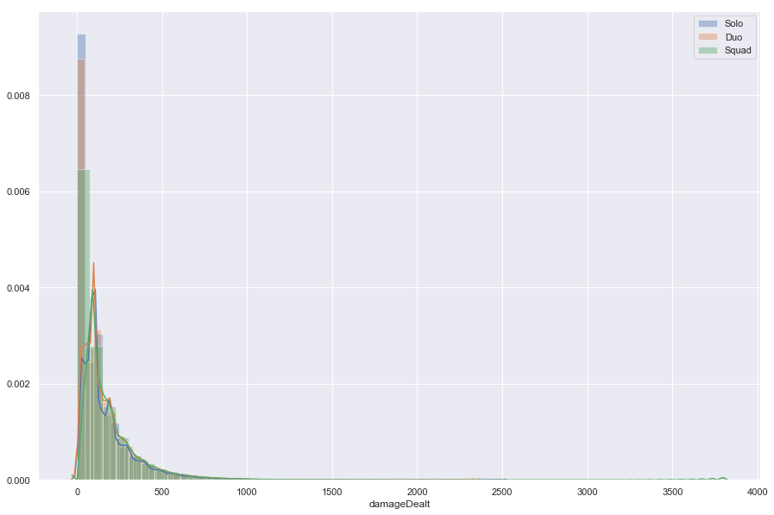
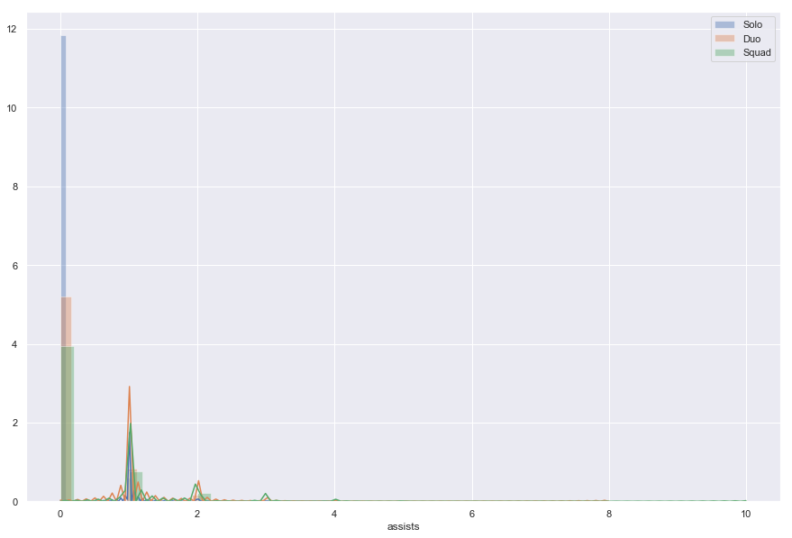
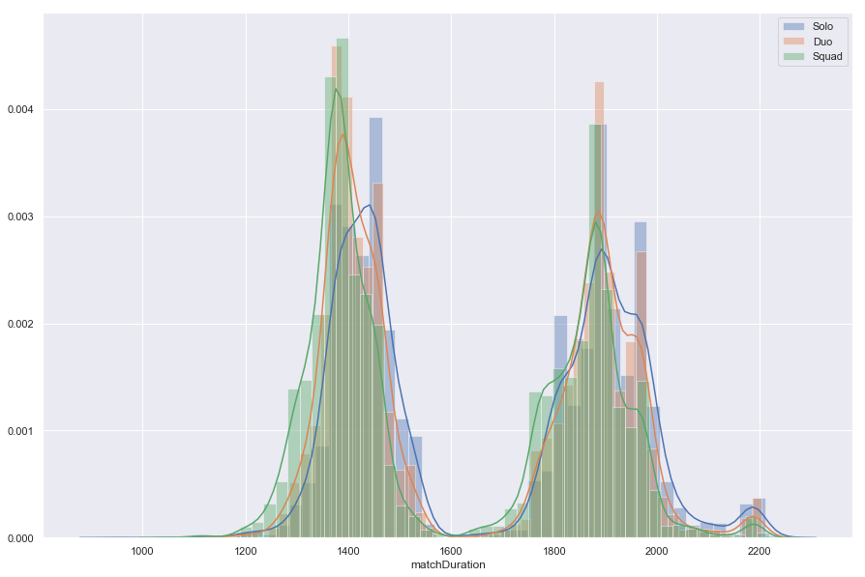
Data Visualization (EDA) – Solo/Duo/Squad:

Slide 25
Step 4: Inferential Statistics
4

Slide 26
Inferential Statistics:
Along with each of the feature distribution plots, for each game mode I visualized a half-heat map and a cluster map of the features that can be seen in the following slides. Finally, in order to confirm our visual suspicions that the different game modes’ feature distributions are significantly different from each other, I conducted a Mann-Whitney U test that provided me with a p value of less than .05. This is important, as it allows me to combine our game modes’ data when building models in the next step, giving me a larger pool of data to work from.

Slide 27
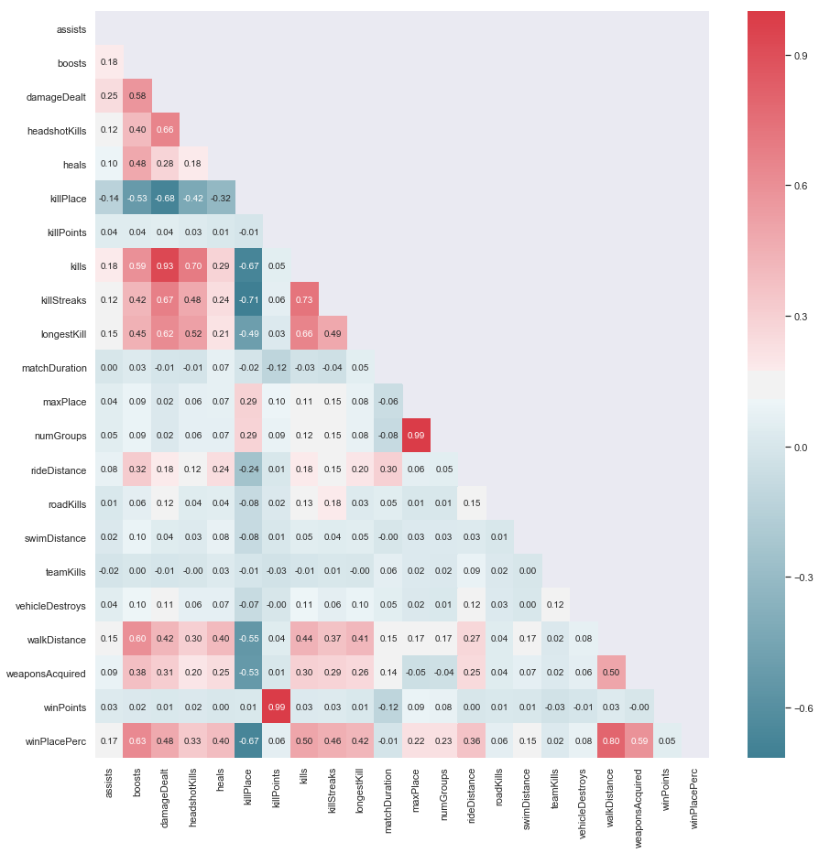
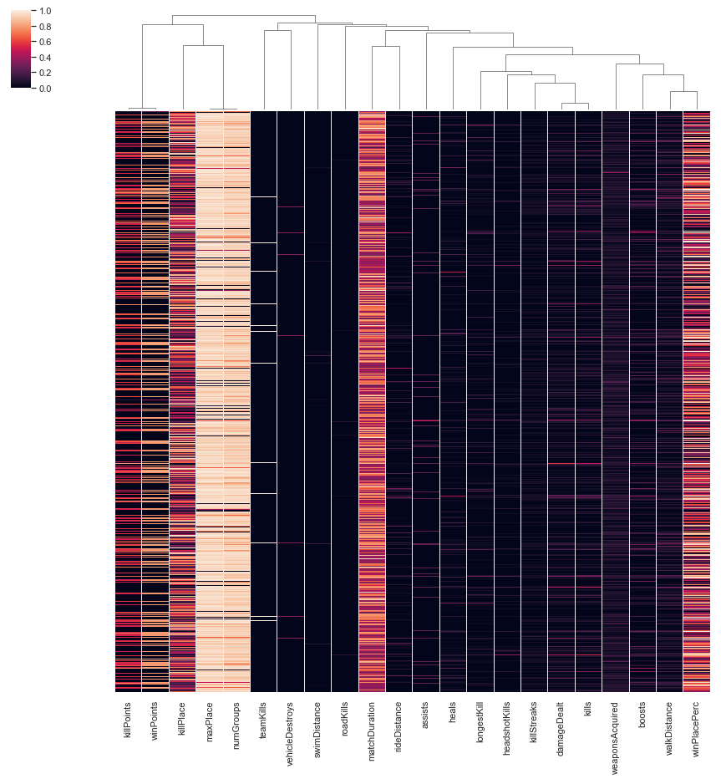
Inferential Statistics – Solo Heatmap/Clustermap:

Slide 28
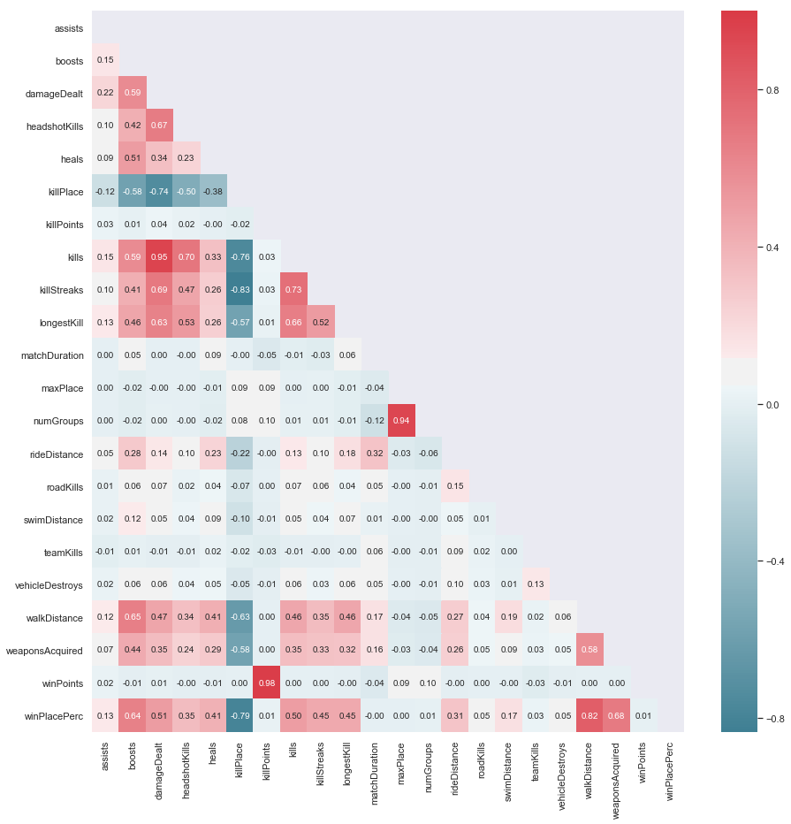
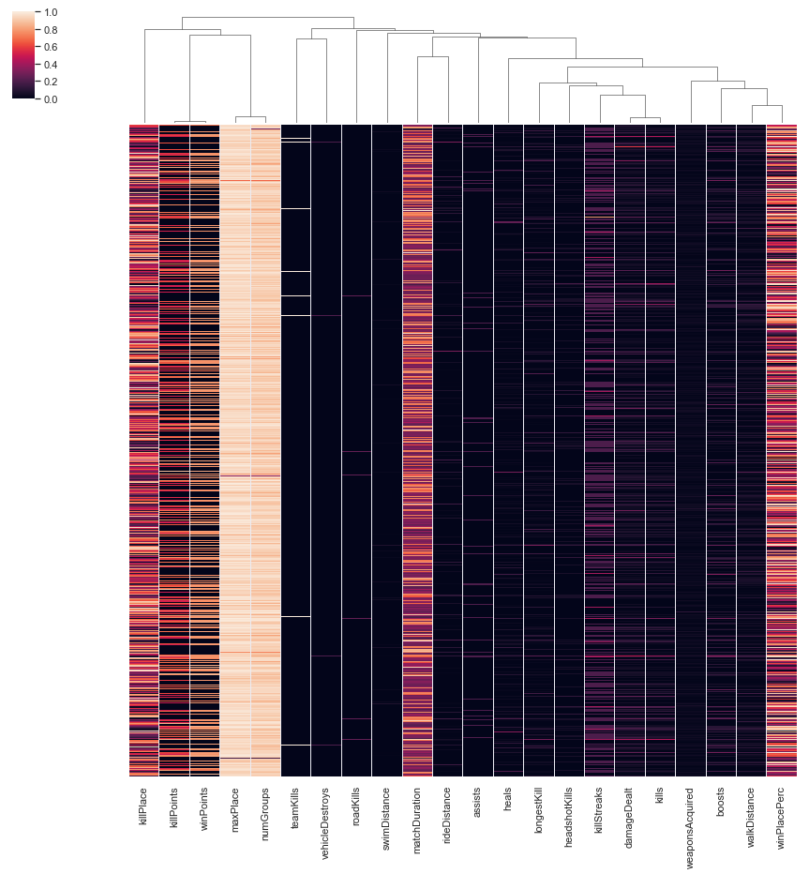
Inferential Statistics – Solo FPP Heatmap/Clustermap:

Slide 29
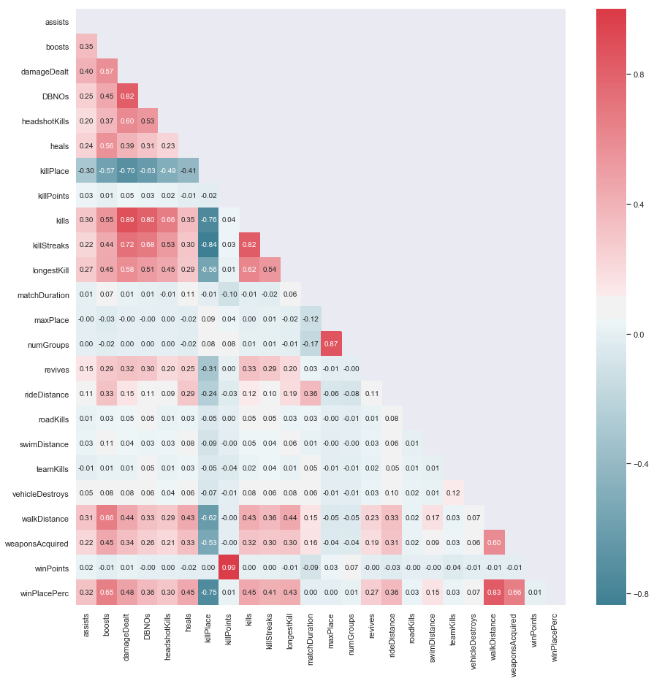
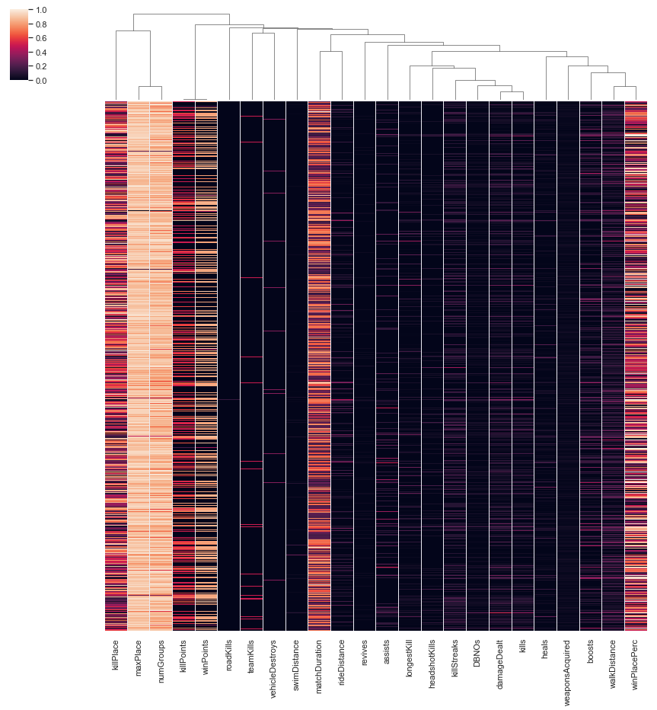
Inferential Statistics – Duo Heatmap/Clustermap:

Slide 30
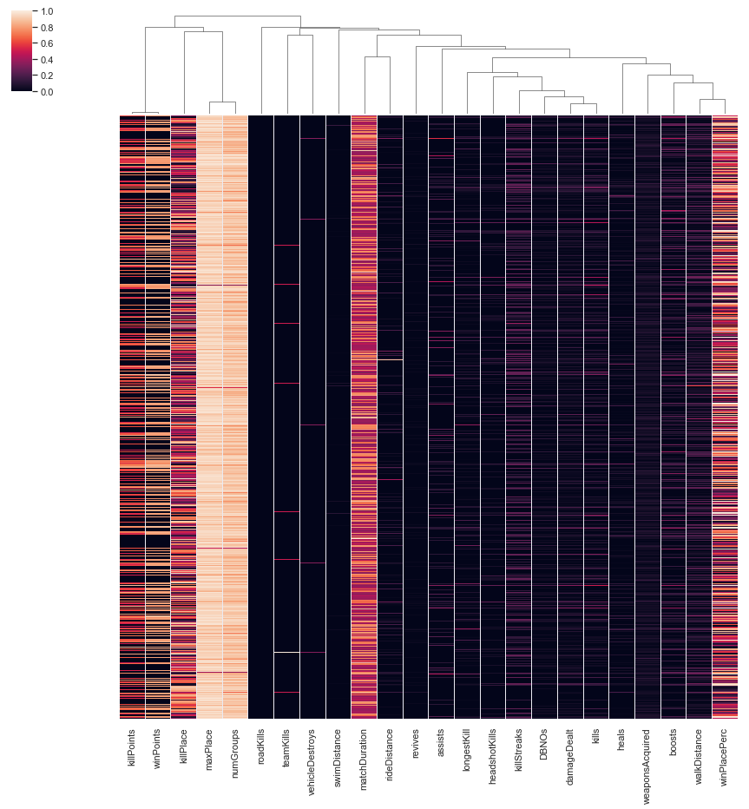
Inferential Statistics – Duo FPP Heatmap/Clustermap:

Slide 31
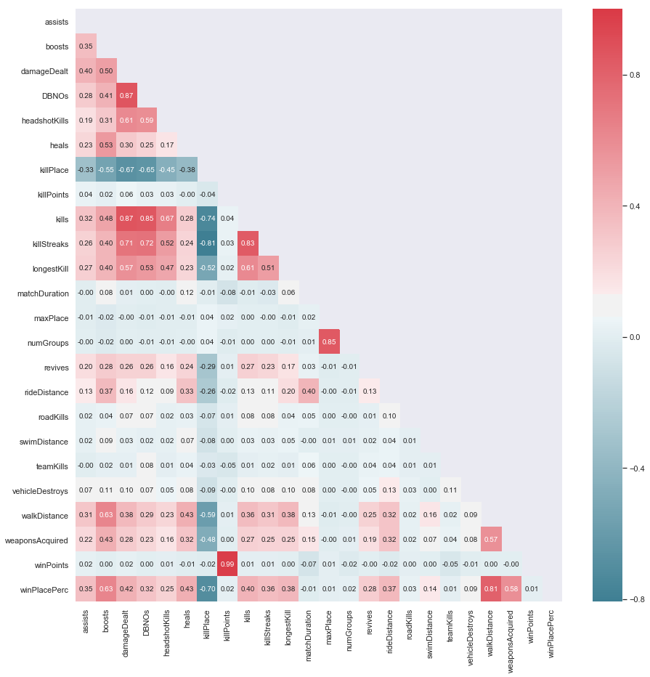
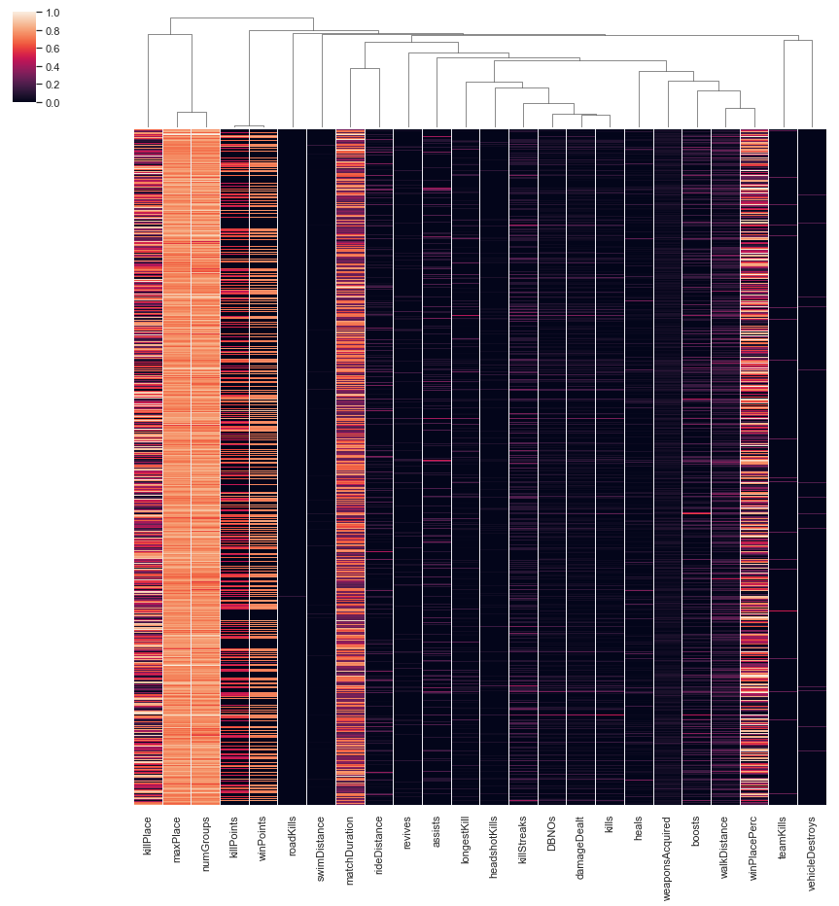
Inferential Statistics – Squad Heatmap/Clustermap:

Slide 32
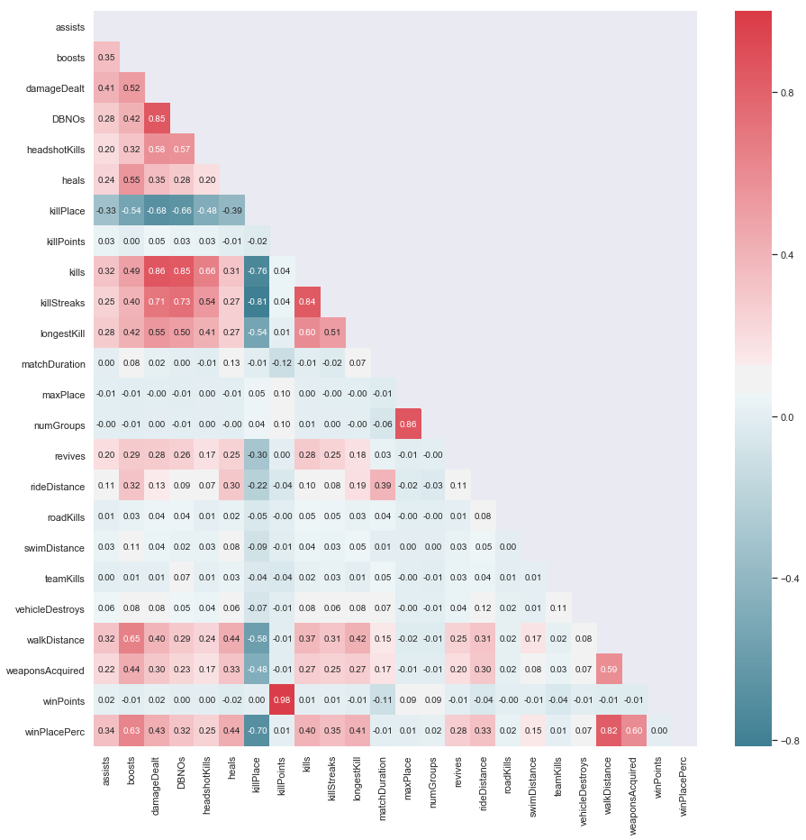

Inferential Statistics – Squad FPP Heatmap/Clustermap:

Slide 33
Step 4: Machine Learning
5

Slide 34
Machine Learning:
As building a model with 5 million rows of observations to start would greatly increase the time needed to finish my project, I started by building models for specific game modes (Solo, Solo FPP, Duo and Squad). I also tested 3 different ways of building a predictive model to determine win placements: ElasticNet, Random Forest and Keras. Using the conclusion drawn from my comparison tests, I would be able to apply all my parameter tuning and keras model tuning to my final model based off the results from the individual models.

Slide 35
Machine Learning:
As building a model with 5 million rows of observations to start would greatly increase the time needed to finish my project, I started by building models for specific game modes (Solo, Solo FPP, Duo and Squad). I also tested 3 different ways of building a predictive model to determine win placements: ElasticNet, Random Forest and Keras. Using the conclusion drawn from my comparison tests, I would be able to apply all my parameter tuning and keras model tuning to my final model based off the results from the individual models.

Slide 36
Machine Learning - Solo:
After importing the solo game mode data into a dataframe, I split it up into a training set, a test set and a validation set with these parameters:
Training Features Shape: (101888, 21)
Training Labels Shape: (101888,)
Validation Features Shape: (25472, 21)
Validation Labels Shape: (25472,)
Testing Features Shape: (54583, 21)
Testing Labels Shape: (54583,)
To confirm what I saw in the initial EDA with the cluster maps, I used hierarchical clustering to draw a dendrogram of the solo game features seen in the next slide

Slide 37

Machine Learning - Solo:

Slide 38
Machine Learning – Solo (ElasticNet):
Using a crossfold-validation factor of 5, I fit my model to the training data and tested it against the validation and test data giving me values of R^2 = .797, Mean Absolute Error (MEA) = .1034 for the validation data and R^2 = .799, MEA = .1035 for the test data.

Slide 39
Machine Learning – Solo (Random Forest):
I start with parameter tuning. Setting up a for loop with our parameter value ranges I fit a model using the training data and finish by evaluating the OOB score, the R^2 score and the RMSE to determine the best parameters to use for our Random Forest Model.
Using the results from parameter tuning, I chose the values of n_estimators = 10, max_depth = 15, max_features = 15 to build my Random Forest model. Doing so after combining my validation and training data sets, my model evaluated scores of R^2 = .937 and a Mean Absolute Error of .047 on the test set.
Going further, I wanted to see if there were any features that were particularly important and also to test if I could refine the model with feature selection. The results are as shown in the next slide.
Choosing the 5 most important features, I rebuild my Random Forest model and achieve an R^2 score of .922 and a Mean Absolute Error of .052, indicating that refining the features used in building my model does not provide any benefit to the final model’s accuracy.

Slide 40

Machine Learning - Solo:

Slide 41
Machine Learning – Solo (Keras Model):
While working with the solo dataset, I conducted multiple keras tests to try to optimize a deep learning model. The parameters of the basic model I chose to use was implemented with:
Sequential model
Three Dense layers
Two with 10 nodes and the “relu” activation
One with only one node as the output
“adam” as the optimizer
“mean_absolute_error” as the loss function
20% validation split
30 epochs with an early stopping monitor with it’s patience set to 10
In the following slide, I will tabulate my model variants as well as their mean absolute error.

Slide 42
Machine Learning – Solo (Keras Model):
Variation | Specific Changes | Mean Absolute Error
Basic Model | N/A | .1411
Higher Node Count | Nodes = 200 | .0656
Lower Learning Rate with Higher Epochs | LR = 1e-4 epochs = 50 | .3160
Increased Layers | Non output layers increased to 4 | .0642
Increased Layers and Higher Node Count | Nodes = 200 Non output layers = 4 | .0508
Increased Epoch Count on above variant | Same as above but epochs set to 100 | .0497

Slide 43
Machine Learning – Solo (Keras Model):
Along with adjusting the parameters of the basic keras model, I also tested different optimizers to see which would give me the best performance. The parameters of the basic model I chose to use for these tests were:
Sequential model
5 Dense layers
4 with 150 nodes and the “relu” activation
One with only one node as the output
“mean_absolute_error” as the loss function
20% validation split
100 epochs with an early stopping monitor with it’s patience set to 10
In the following slide, I will tabulate my model variants as well as their mean absolute error.

Slide 44
Machine Learning – Solo (Keras Model):
Optimizer Used | Mean Absolute Error
Adam | .267
Adagrad | 1.45
Adadelta | 2.81
Nadam | .248
Adamax | .233

Slide 45
Machine Learning – Solo (Keras Model):
Finally, under the suggestion of my mentor, I looked into implementing an LRFinder Class. Using resources from the internet and some tweaking, I defined a class called LRFinder that finds the optimal learning rate for a neural network by logging the loss values over a model as the learning rate exponentially increase within the given bounds. In addition, this class also allows you to plot this change in loss over the learning rates to give a visual way of determining the optimum learning rate.
Setting my bounds to go from 1e-8 to 10 in batch sizes of 1000 and repeating over 100 epochs, I determined that the optimal learning rate is just under 1e-4. The plotted loss function can be seen in the next slide.

Slide 46

Machine Learning – Solo (Keras Model):

Slide 47
Machine Learning – Other Game Modes:
From this point on, I built various models for the different game modes. For each, I built a Random Forest model with the parameters:
n_estimators = 10
max_depth = 15
max_features = 15
For the Keras models, I chose parameters that would minimize the time taken to build the model as well as minimizing the loss function:
Model type = Sequential
4 Dense layers of 10 nodes each with “relu” activation with an output layer
Compiler = nadam
Loss = mean_absolute_error
20% validation split and 30 epochs with a 10 count patience early stopping monitor.

Slide 48
Machine Learning – Other Game Modes:
The games modes tested are as follows:
Squad
Training Features Shape: (438568, 23)
Training Labels Shape: (438568,)
Testing Features Shape: (187958, 23)
Testing Labels Shape: (187958,)
Duo
Training Features Shape: (219513, 23)
Training Labels Shape: (219513,)
Testing Features Shape: (94078, 23)
Testing Labels Shape: (94078,)
Solo FPP
Training Features Shape: (375732, 21)
Training Labels Shape: (375732,)
Testing Features Shape: (161029, 21)
Testing Labels Shape: (161029,)
Duo/Squad combined
Training Features Shape: (658081, 23)
Training Labels Shape: (658081,)
Testing Features Shape: (282036, 23)
Testing Labels Shape: (282036,)
Solo/Solo FPP combined
Training Features Shape: (503092, 21)
Training Labels Shape: (503092,)
Testing Features Shape: (215612, 21)
Testing Labels Shape: (215612,)

Slide 49
Machine Learning – Other Game Modes:
Game Mode | ML Model | Mean Absolute Error
Squad | Random Forest | .072
Squad | Keras | .078
Duo | Random Forest | .054
Duo | Keras | .065
Solo FPP | Random Forest | .041
Solo FPP | Keras | .051
Duo/Squad | Random Forest | .066
Duo/Squad | Keras | .076
Solo/Solo FPP | Random Forest | .042
Solo/Solo FPP | Keras | .049

Slide 50
Machine Learning – Non Standard Game Modes:
Lastly, although it only accounted for less than 1% of the games in our data set, I needed to include a model that would be able to predict win placements in non standard game modes.
To do this, as I did not have enough data to build a keras model, I used the parameters from the previous sections and quickly put together a Random Forest model. Applying this model to the combined data of all the non standard game modes, I achieve a mean absolute error of .139

Slide 51
Machine Learning – Final Test Models:
Using the best parameters as tested above, we combine Solo and Solo FPP into one dataset (Solo game modes) and combine Duo/Duo FPP/Squad/Squad FPP into one dataset (Multiplayer game modes) and build an RF model and a Keras model for each.
Solo Game Modes
Data Shape
Training Features Shape: (503092, 21)
Training Labels Shape: (503092,)
Testing Features Shape: (215612, 21)
Testing Labels Shape: (215612,)
Random Forest
Mean Absolute Error: 0.041945014034447094
Keras
Mean Absolute Error: 0.06638968754153332
Multiplayer Game Modes
Data Shape
Training Features Shape: (2585095, 23)
Training Labels Shape: (2585095,)
Testing Features Shape: (1107899, 23)
Testing Labels Shape: (1107899,)
Random Forest
Mean Absolute Error: 0.061807421502185954
Keras
Mean Absolute Error: 0.07021288031672876

Slide 52
Step 4: Conclusion
6

Slide 53
Kaggle Data Competition Submission:
From the beginning, this project was based off of a kaggle competition (https://www.kaggle.com/c/pubg-finish-placement-prediction) and therefore I completed the project by creating a CSV file for submission. The steps taken to do so are outlined here:
Review the sizes of the training and test files:
Training Data's Shape: (4446966, 29)
Testing Data's Shape: (1934174, 28)
Split up the training data set into solo game modes, multiplayer game modes and non standard game modes as well as splitting each group of games into the respective training features and labels. The number of games for each mode is found here:
Solo game modes: 718704
Multiplayer game modes: 3692994
Non standard game modes: 35267
Construct a Random Forest model for each of these game modes separately using the optimal parameters as tested in the previous sections.

Slide 54
Kaggle Data Competition Submission:
From the test data files, I also split up the data into solo/multiplayer/non standard game modes. The respective sizes of each of these dataframes are:
Standard Solo Games Shape: 313767
Standard Multiplayer Games Shape: 1610569
Non Standard Games Shape: 9838
Total Games Shape: 1934174
These test dataframes are then pared down to include the necessary features as well as the each row’s Id column’s value.
Using the three different RF models I built in step 3, I found and stored the predicted win place percentages into 3 different arrays.
Finally, I concatenated the respective ID value with the corresponding win place percentage for each game mode, then stacked the predictions on top of each other to complete the final prediction dataframe.
Using pandas’ built in to_csv method, this dataframe is then exported as a CSV file that was used to submit to Kaggle for evaluation.

Slide 55
Conclusions:
This concludes the report on my 2nd capstone project, PUBG Final Placement Predictions. Some interesting things to note are:
Because this project is based off of a Kaggle competition, the data that I used had seemingly already been scrubbed. When it comes to real world projects, this should not be the case and for future projects a heavier emphasis on the initial data wrangling will be necessary.
During the intial EDA, when looking at the highly correlated features with respect to the win place percentage, the ones that stood out the most did not give very much insight into the question of “What makes a player good at the game?” Specific features such as “walking distance” and “weapons acquired” do not give any indication of player skill level; they are just byproducts of staying alive longer which necessarily translate to a higher win placement within a game.
Although far more time was put into tuning the deep learning keras models used in this capstone project, ultimately the random forest models built showed better results. This is a testament to the strength of a Random Forest model and how it can be used as an ensemble method to capture highly non-linear data sets.

Slide 56
Future Work:
Some possible future work that could be done to expand on this project are:
More dedicated time towards running deep learning keras models. As found in our intial parameter testing for the deep learning models used, I found that the optimal learning rate was at 10⁻⁴. In order to test and build models using this far smaller learning rate, a much higher epoch count must be used to compensate. Due to time constraints in this project (and possibly hardware constraints as well), future keras models could be built with these new parameters and left to run without an early stopping monitor to see if a more accurate model can be built.
Using more data to build the deep learning models. I believe that deep learning models will outperform the standard out of the bag Random Forest models that I’ve used to build my final submission predictions. However, as I add more neurons and layers into the model and increase the features being tested, the data needed to build the model scales up as well.
Creating a hybrid model: Although the details of how to proceed with this type of model is unclear to me, under my mentor’s suggestion I have looked into publications that combine deep learning neural nets with an ensemble method like Random Forest to build a hybrid model.

